Slide 1
Gesture Classifier
Anne Ross

Slide 2
Visualize the Data
Padded with the mean

Slide 3
Try transforming data
Focused on the magnitude

Slide 4
Choosing Transformations
From here on out focused on magnitude
Based on the data visualizations, scaling and smoothing looked to the be most promising techniques, of those discussed in the slides
Scaling especially for shake and other
Also played with descaling and offsetting just to see

Slide 5
Visualizing Transformations

Slide 6
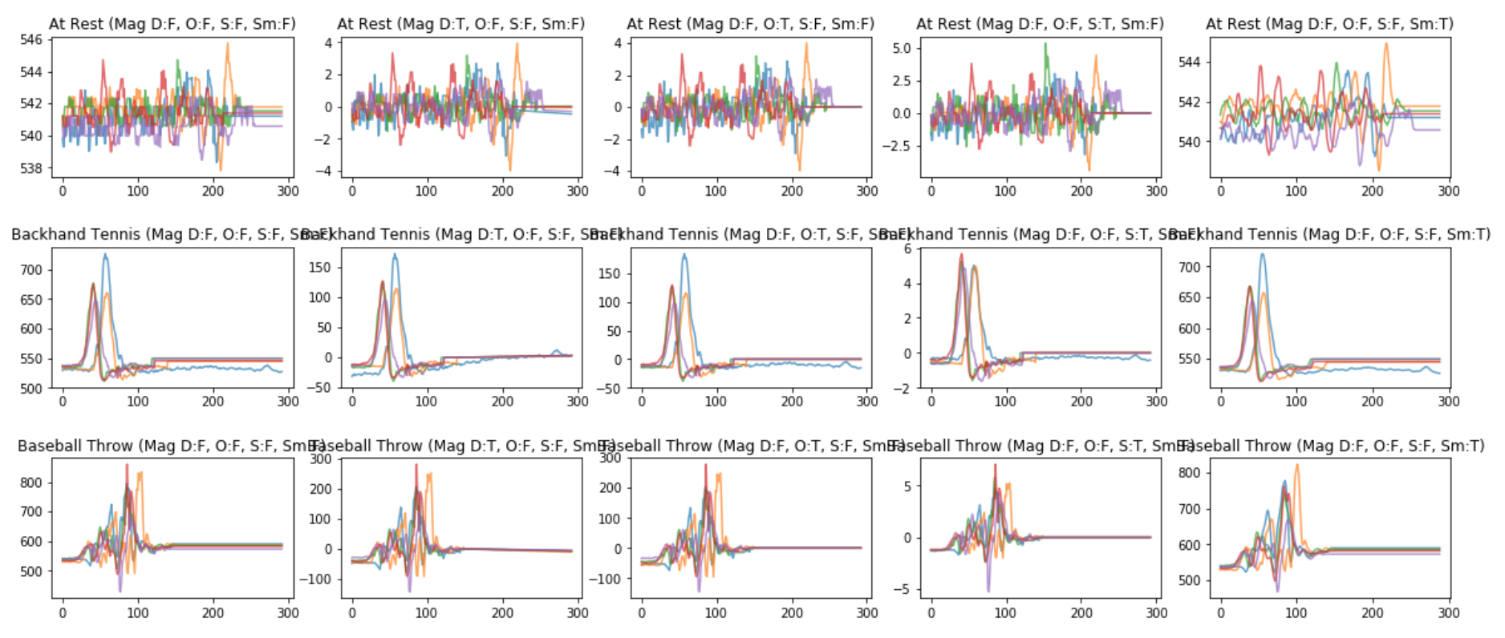
Annie Gestures
No Transform
Detrended
Offset
Scaled
Smoothed
Alone, most transformations didn’t make a huge impact. Scaling seems most promising

Slide 7
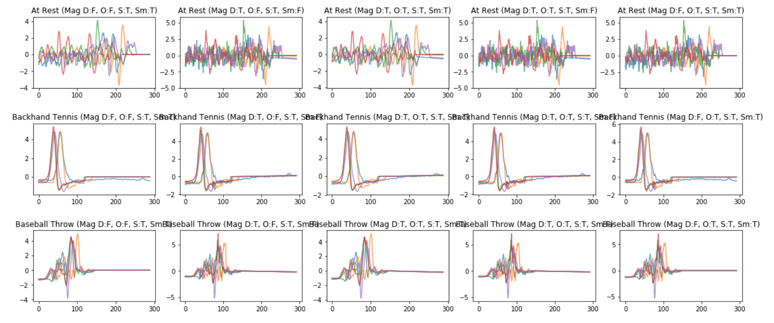
Annie Gestures
Detrended, offset, scaled, smoothed
Detrended, Scaled
Detrended, offset, scaled
Offset, scaled, smoothed
Scale, Smooth
Combinations of transformations did not appear to make a large difference either

Slide 8
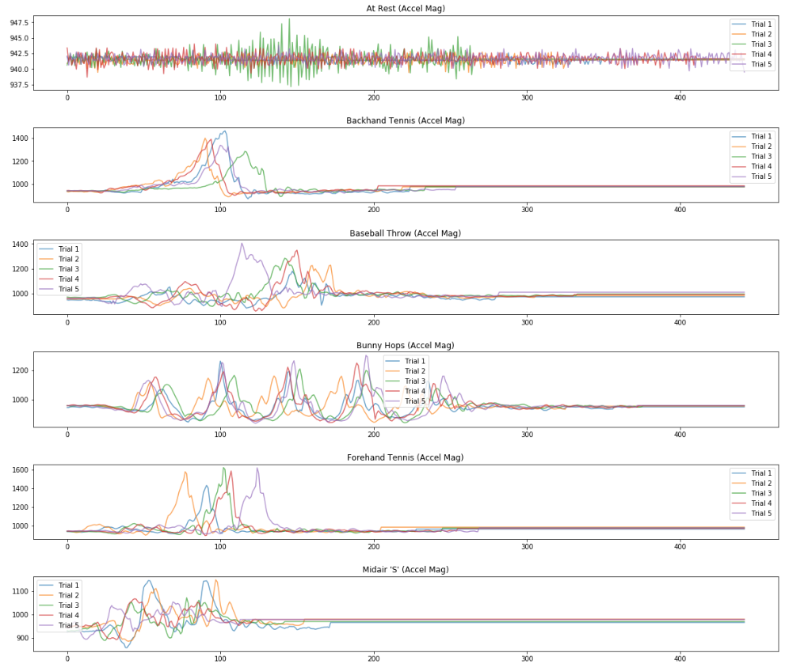
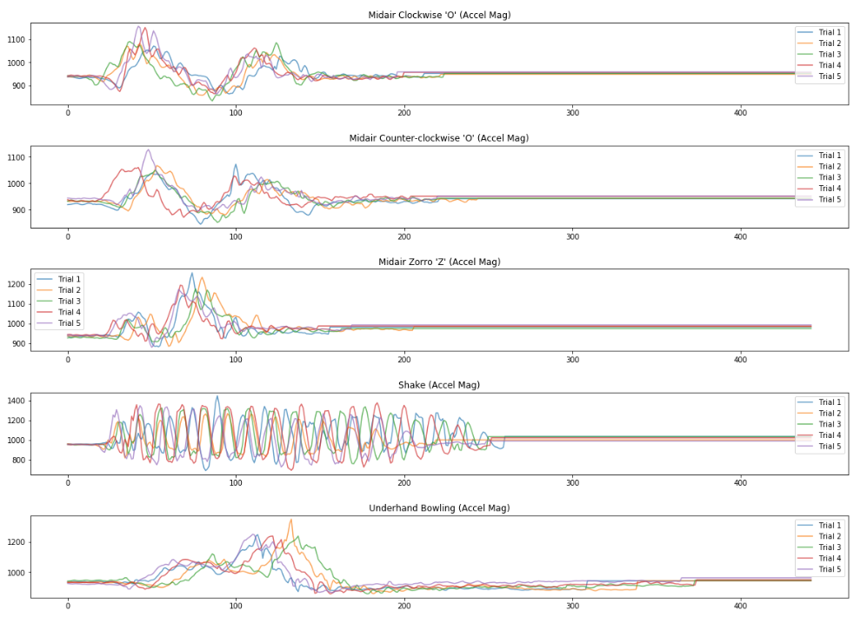
Jon Gesture, pad with mean, for reference

Slide 9
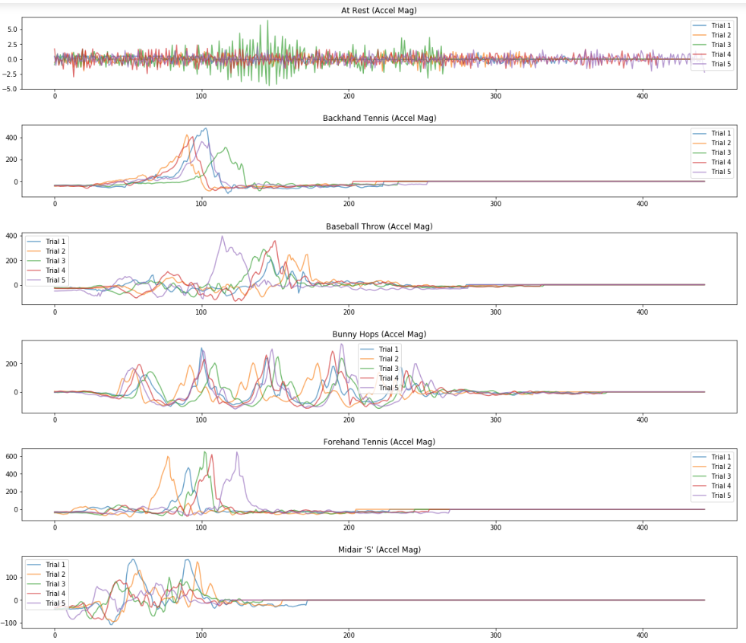
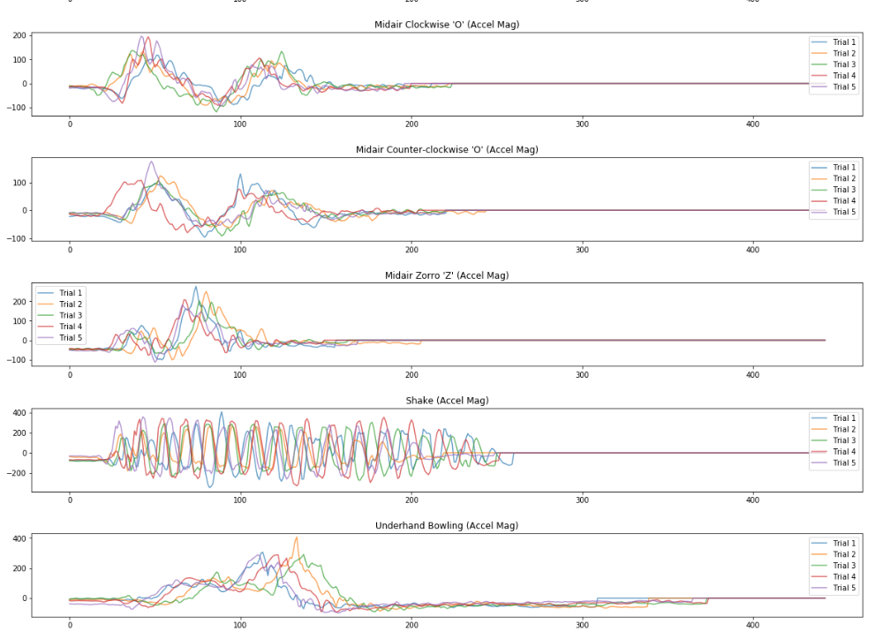
Jon Gesture, pad with mean, offset:
Made slight differences in alignments of a few trials (e.g. Midair Zorro ‘Z’) but doesn’t seem like a significant improvement

Slide 10
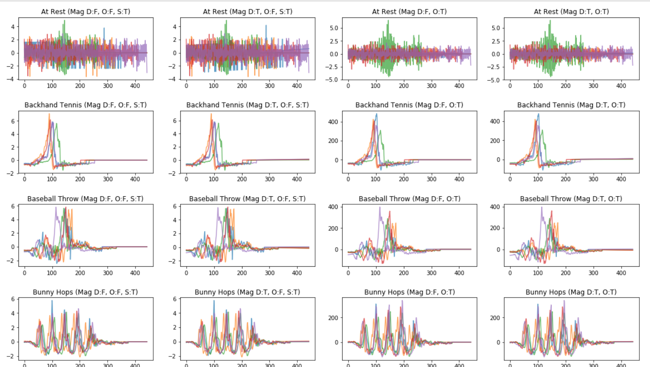
Jon Gesture, pad with mean, comparing transformations
offset
Offset and detrended
Scaled and detrended
scaled

Slide 11
Testing Gesture Recognizer

Slide 12
Gesture Recognizer
Created 5 folds by randomly assigning one of each gesture to each group
For each round, 4 folds created the training set and 1 fold was the testing set
The process was repeated so that each fold was the testing set for a round
Each gesture in the testing set was compared to each gesture in the training set. The label from the train-set gesture with the lowest distance was used as the label for the test gesture
Raw Euclidean distance and DTW were tried for the distance metric

Slide 13
Euclidean Distance

Slide 14
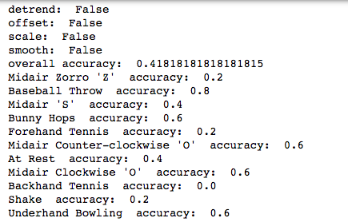
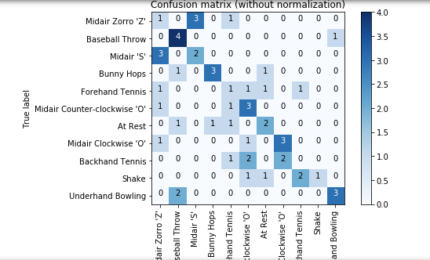
Jon Gesture, padded with mean, no filters
Not great accuracy at only 42% overall and some gestures well below 50%

Slide 15
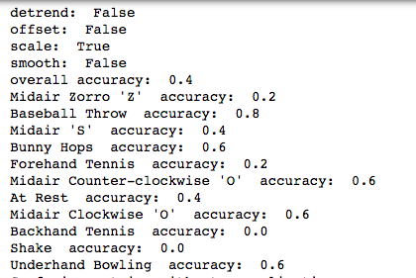
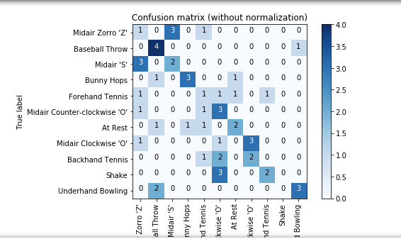
Jon Gesture, pad with mean, scaled
No improvement with transformation

Slide 16
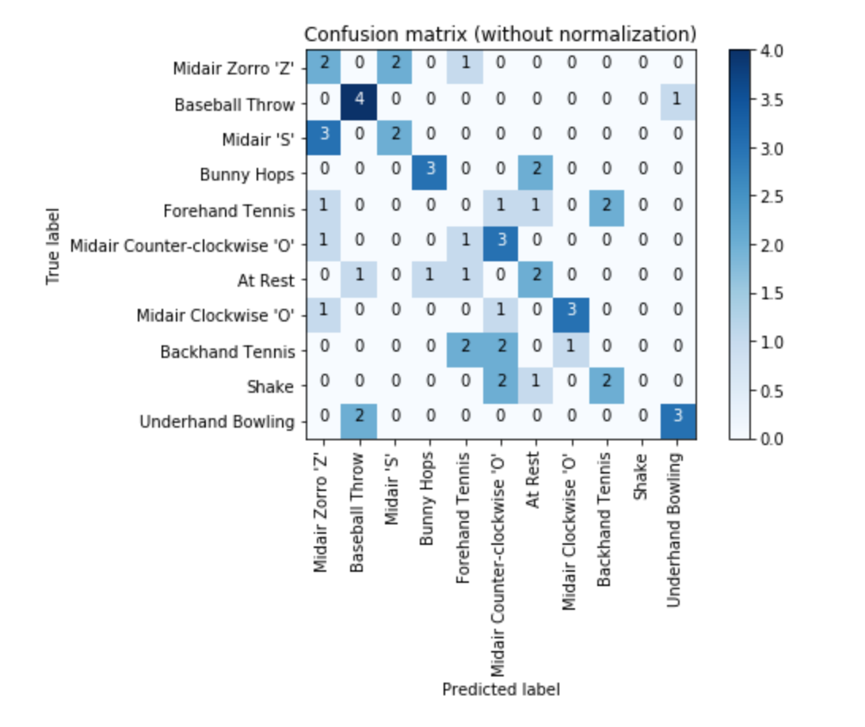
Jon Gesture, pad with mean, offset and scaled
detrend: False offset: True scale: True overall accuracy: 0.4 Midair Zorro 'Z' accuracy: 0.4 Baseball Throw accuracy: 0.8 Midair 'S' accuracy: 0.4 Bunny Hops accuracy: 0.6 Forehand Tennis accuracy: 0.0 Midair Counter-clockwise 'O' accuracy: 0.6 At Rest accuracy: 0.4 Midair Clockwise 'O' accuracy: 0.6 Backhand Tennis accuracy: 0.0 Shake accuracy: 0.0 Underhand Bowling accuracy: 0.6

Slide 17
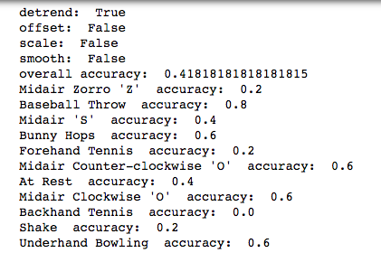
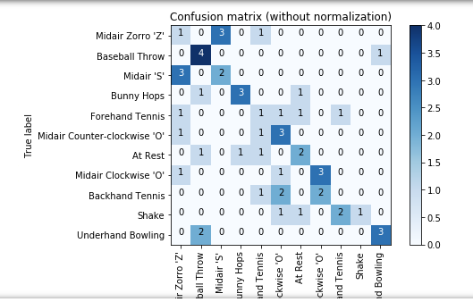
Jon Gesture, pad with mean, detrended

Slide 18
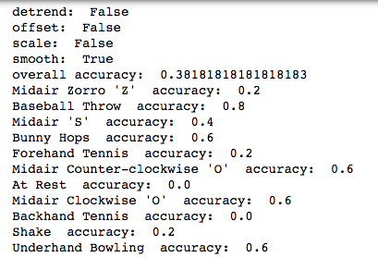
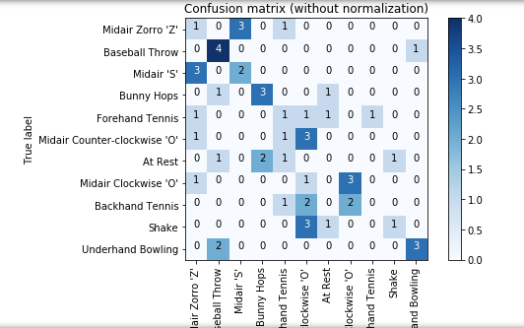
Jon Gesture, pad with mean, smoothed

Slide 19
Discussion
Overall, using Euclidean distance gave low accuracy around 40% regardless of transformations

Slide 20
Annie Logs

Slide 21
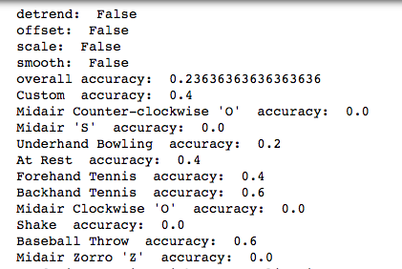
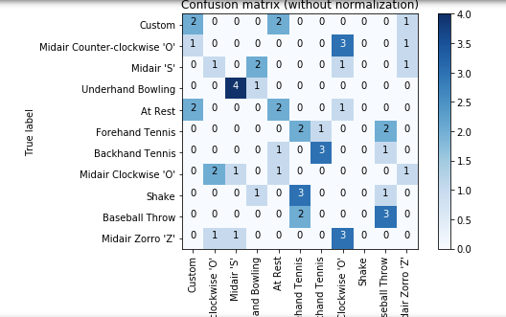
Annie Gesture, pad with mean, no transformation
Messier data set. Really bad accuracy at around 24%

Slide 22
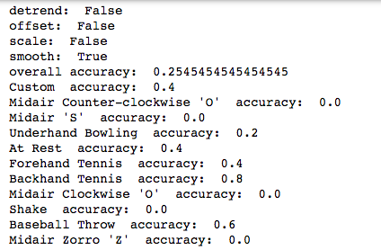
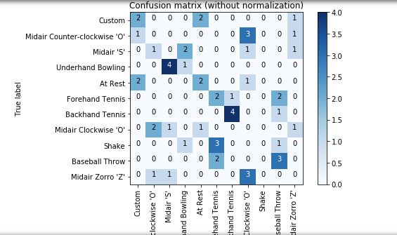
Annie Gesture, pad with mean, smoothed

Slide 23
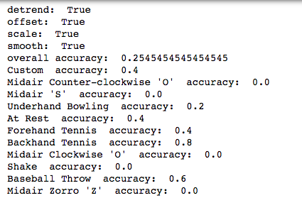
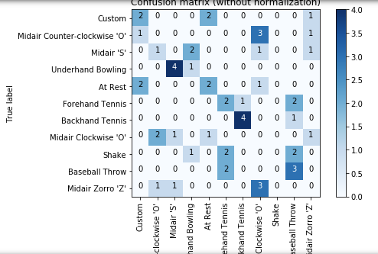
Annie Gesture, pad with mean, detrended, offset, scaled, and smoothed

Slide 24
Reflection
As with Jon’s gestures, transformations did not improve the recognition accuracy for my gestures
Moreover, the base accuracy for mine was worse to begin with

Slide 25
DTW To the Rescue!

Slide 26
Jon’s Data

Slide 27
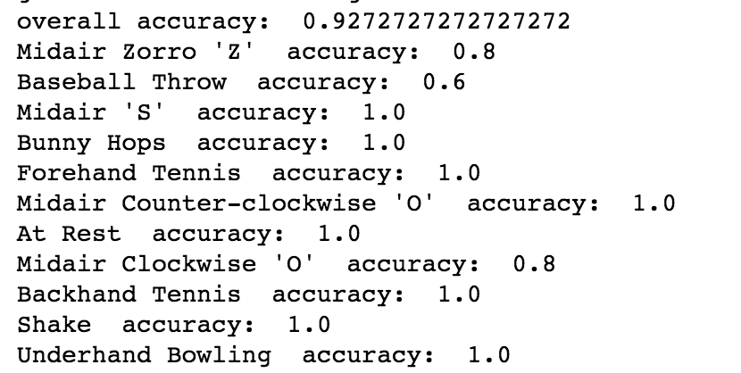
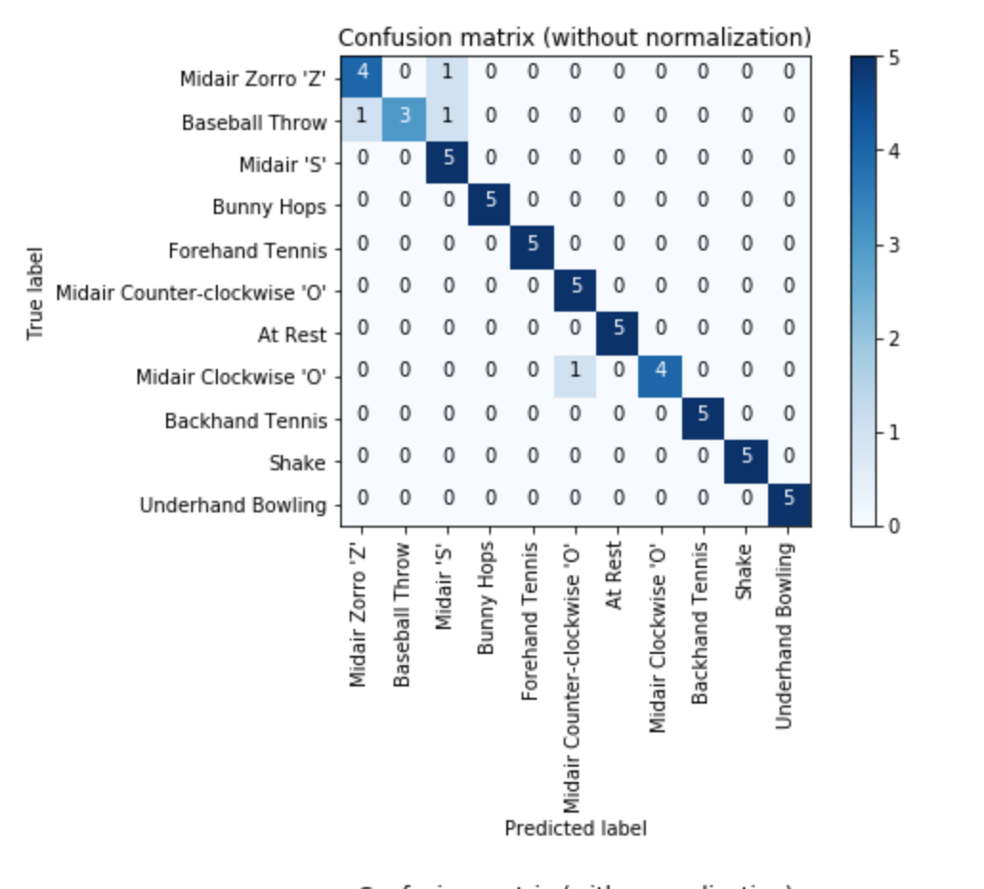
No filters

Slide 28
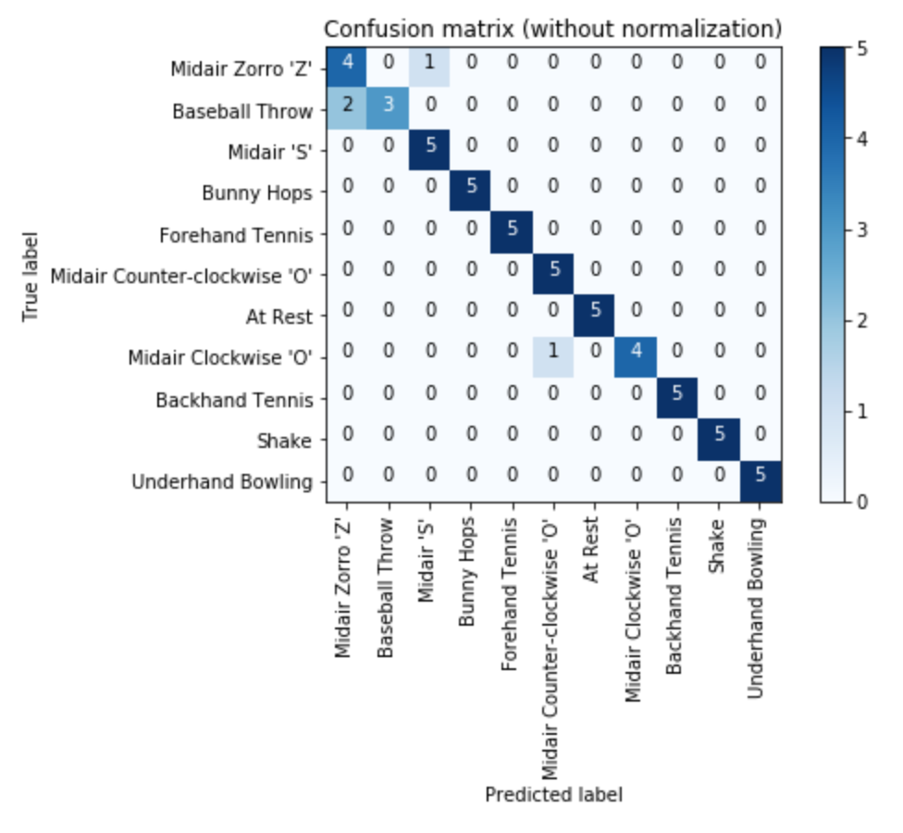
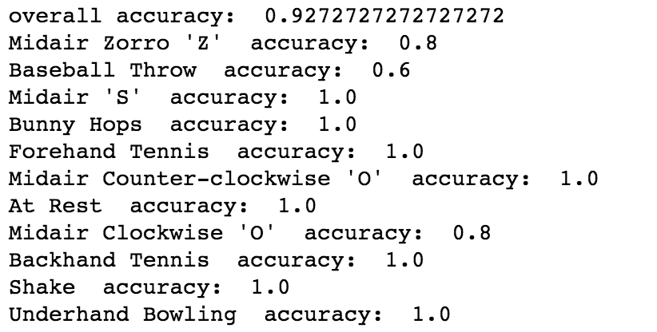
Smoothing only

Slide 29
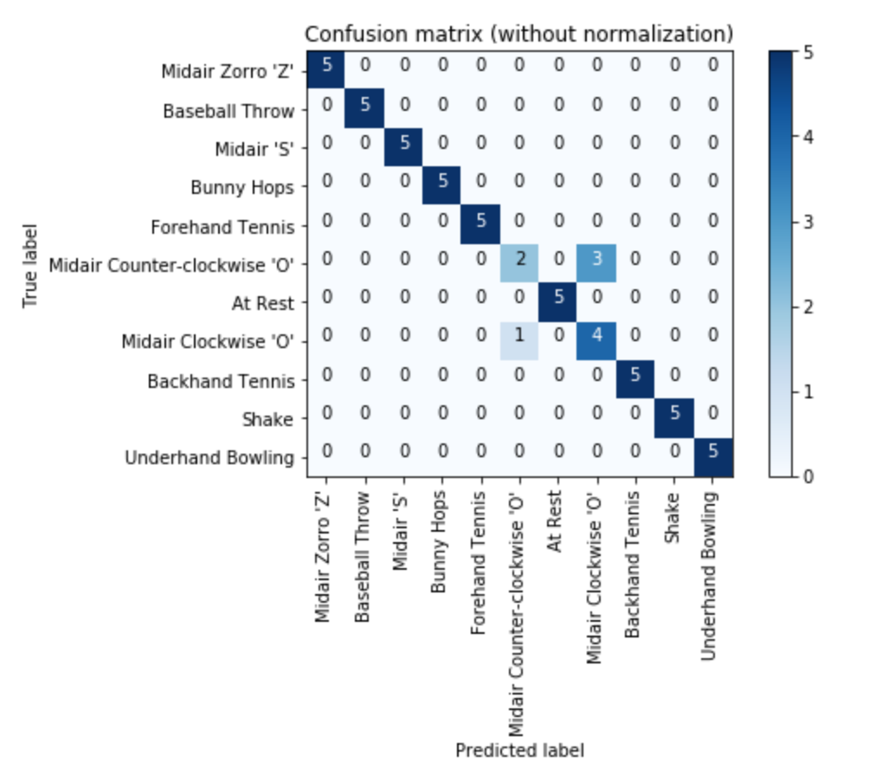
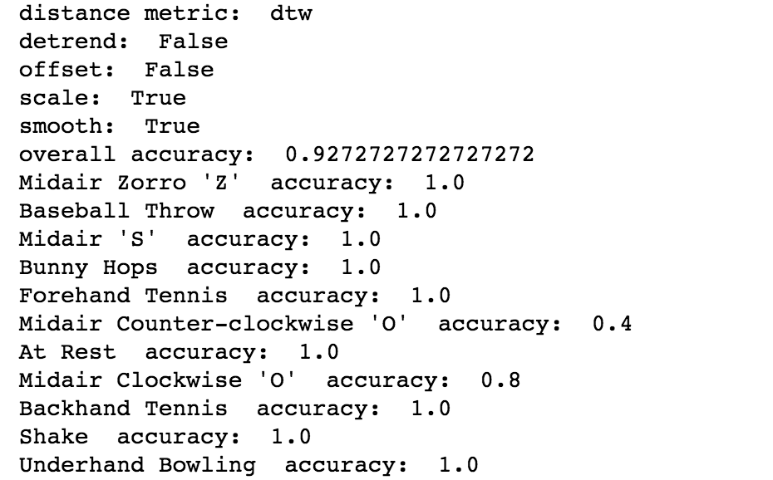
Scaled and smoothed
For the most mis-classified signals (clockwise and counterclockwise ‘O’, using a measurement beyond the magnitude would likely significantly help, as the Y and X accelerometer traces were much more distinct

Slide 30
reflection
Overall, transformations did not appear to significantly affect overall accuracy for Jon’s gestures
However, the different transformations shifted which specific gestures were misclassified
Using measurements beyond just the magnitude may have allowed for a better balance of the transformations and the distinguishability of different gesture traces

Slide 31
Annie’s Data

Slide 32
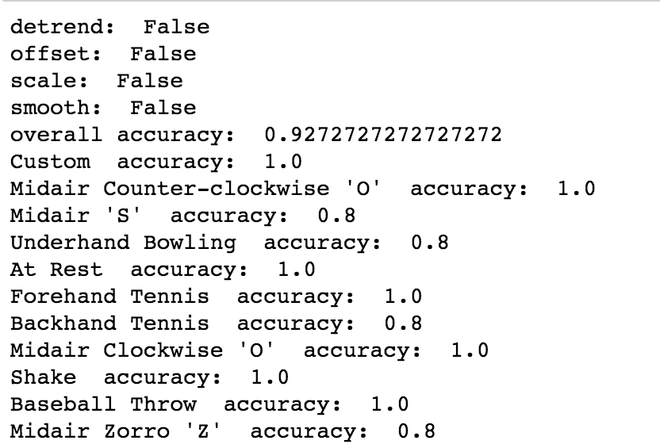
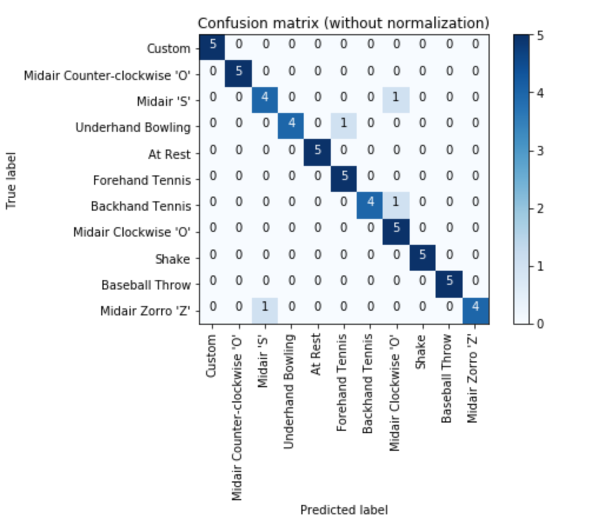
Seems to do well without any transformations (93% accuracy over all)

Slide 33
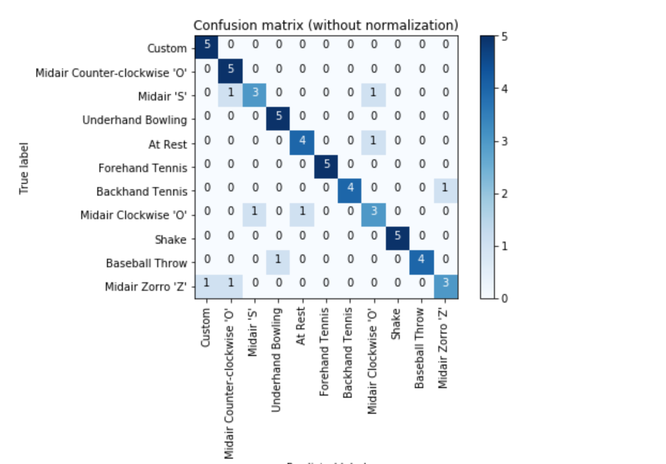
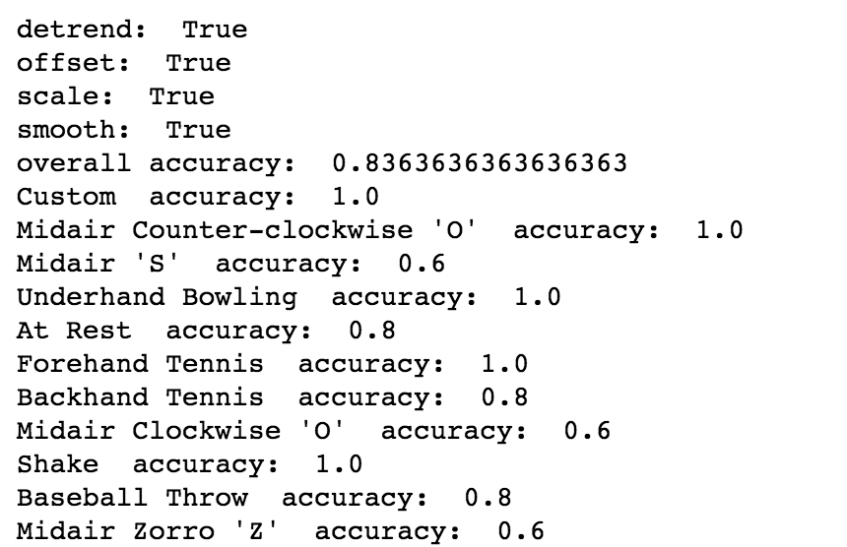
Detrended, offset, scale, smoothed: slightly decreases accuracy

Slide 34
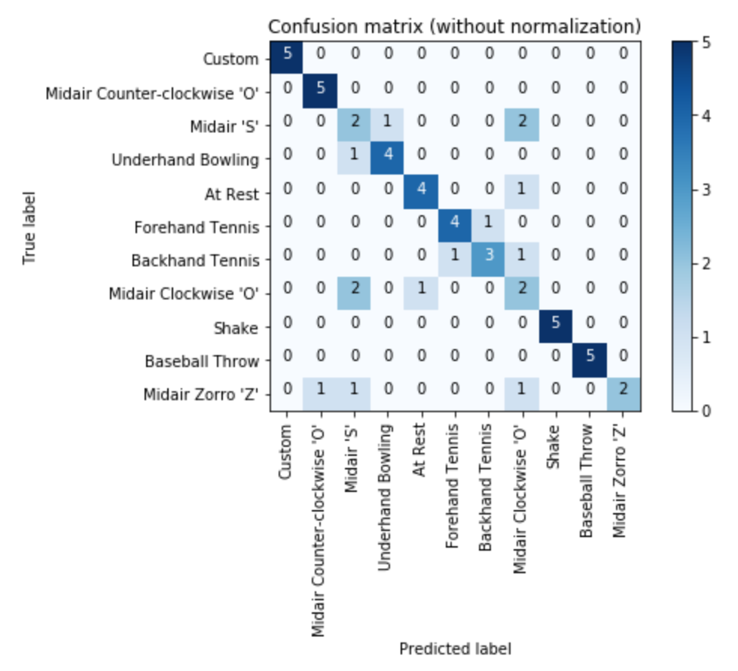
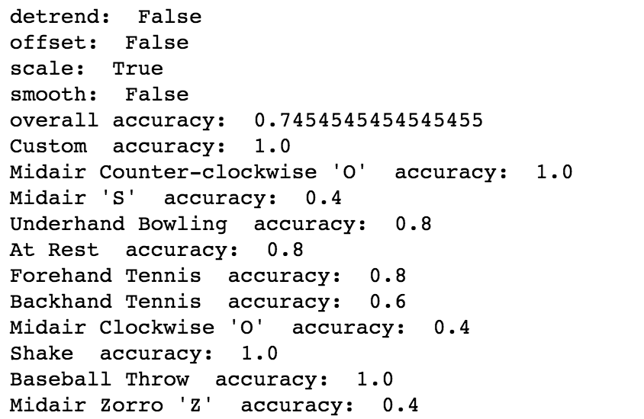
scaled: worse accuracy still

Slide 35
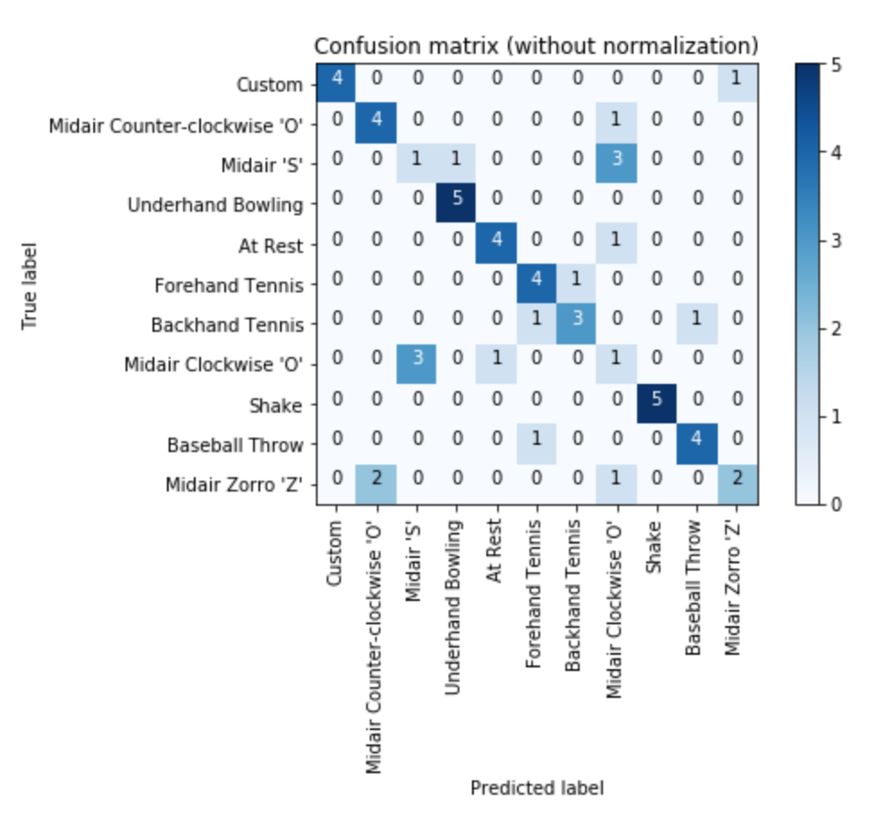
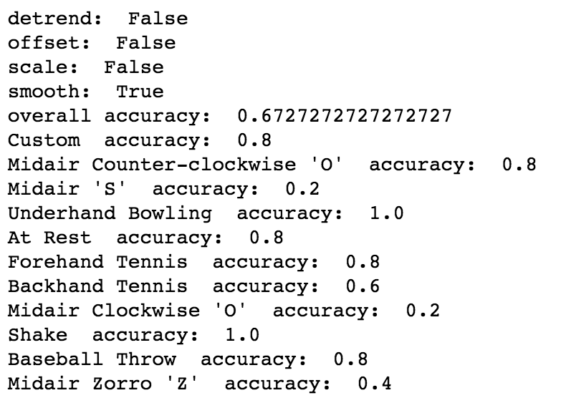
smoothed: and worse still

Slide 36
reflection
Overall, transformations did not help accuracy for classifying my gestures

